Slide 1





TEAM <6>
POWER OUTAGE LIKELINESS ANALYSIS IMPACTED BY HISTORICAL STORM DATA
Alan
Christopher
Li
PSEG RUTGERS ANALYTICS BOOTCAMP PROGRAM
PROJECT 04
Bhagya
Bryan
27 JUNE 2024

Slide 2
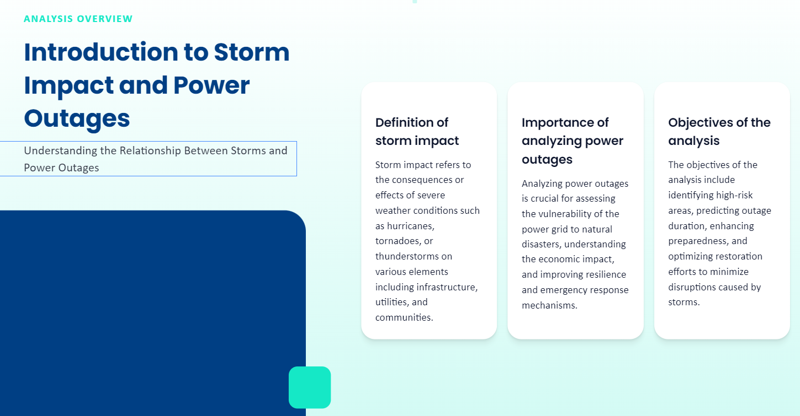
INTRODUCTION
Correlate historic power outage with Storm Data
Energy lines under strain during extreme weather causing power outages
Build Machine Learning models & Data visualization tools to alert potential outages due to a Storm Event

Slide 3
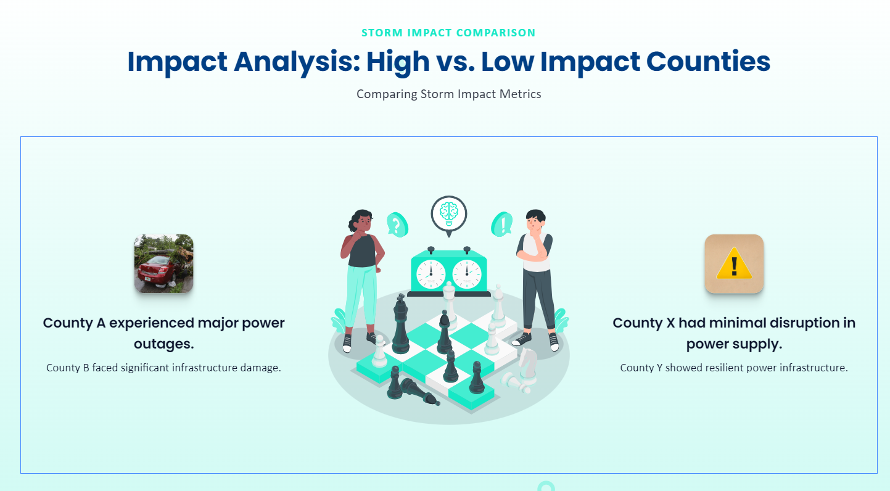
ANALYSIS

Slide 4















DATA ANALYSIS & MACHINE LEARNING DESIGN & TECHNOLOGY ARCHITECTURE
DEFINE
the Problem
GATHER
the Data
COMMUNICATE
Results
Finding Power Outage data paired with Storm Events for counties in USA
Identifying the data sources & Collecting data
Access the results on a lightweight browser
DATA SOURCE - Extract | Transform | Load
Data Store
ML Engine
UI | Visualization
EAGLE-I
Energy Outage
NCEI
Storm Events
EXPLORE
the Data
CLEAN & PREPARE the Data
BUILD
Object Models
Looking for patterns of Power Outages and correlating with Storm Events across counties in USA.
Fine tuning the size of the data
Cleaning the data using Pandas Dataframe.
Preparing the data in AWS S3 bucket
Build real time Machine Learning Models based on characteristics or criteria for client access

Slide 5
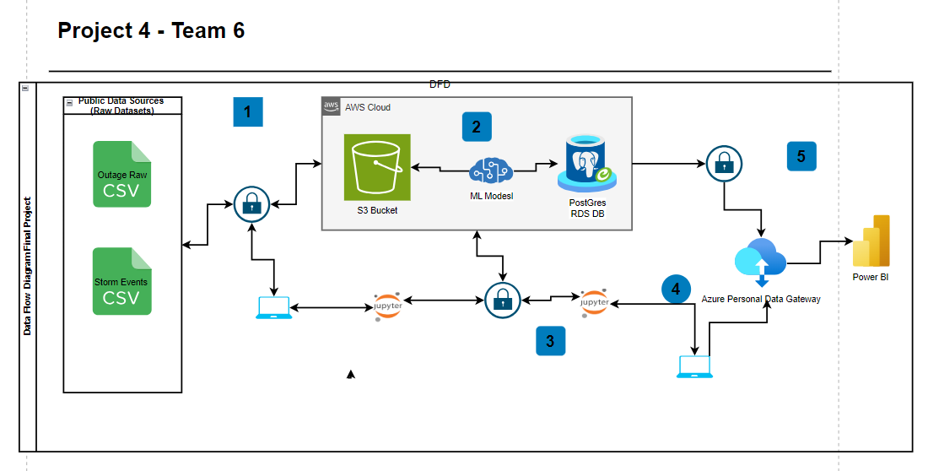
End to End Data Pipeline
Raw Data Sources are ingested into AWS S3
ETL Process with the data in S3 to produce final output and used an ML model to produce training results based on Storm outage and Event Datasets.
We then added the completed dataset to the Postgres RDS database updating the data to the “StormEvents” Schema and producing the “Storm_Outages” dataset.
Power BI Desktop connects to the RDS Database via ODBC connection to pull the dataset from the database to build reports.
Report is published into Power BI Service and connection is established via Power BI Data Gateway.

Slide 6

OBSTACLES | SOLUTIONS
CATEGORY | CHALLENGES | SOLUTION/WORKAROUND
DATA SOURCE | Identify the websites to get the Power Outage and Storm Data | Large volumes of data available both for Power Outage and Storm Data for United States
 | Difficulties building relationships without robust documentation and data definitions | Narrowed the range to just one year
OBJECT MODEL | Running the logical regression model on a local machine crashed | Leveraged Google Colab to run the models Added disk and memory monitor on the notebook to track the machine health
 |  | Further sampled and prepped data to run on a PC without negative impact to model
POSTGRESQL SECURITY | Establishing connectivity from Python to PostgreSQL hosted in AWS | Applied parameterized role to override the default role allowing connection into the database

Slide 7
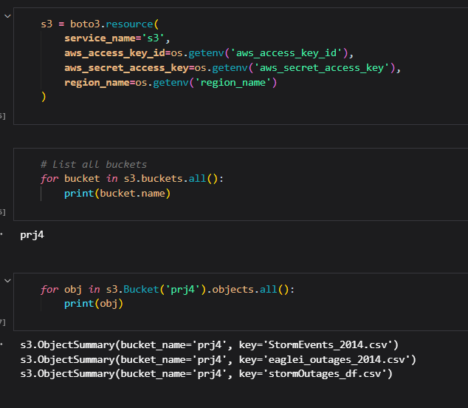
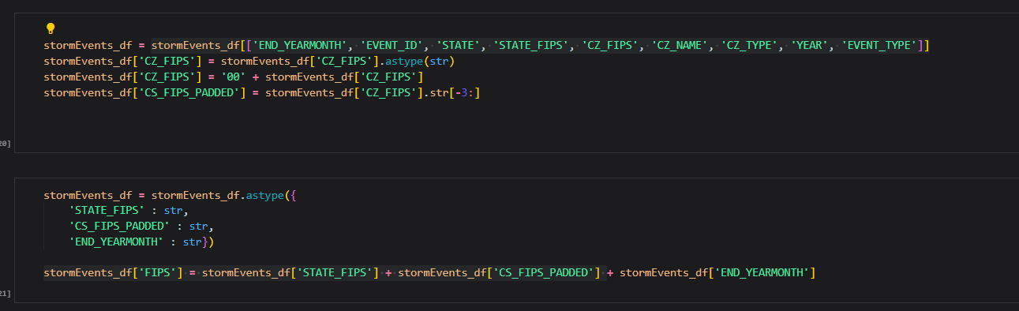
PostgreSQL AWS RDS – ETL Process
Power Outage & Storm Event was manually uploaded to S3 buckets
Connected to S3 buckets using BOTO3 library in python
Cleaned data by removing unnecessary fields, padding county fips field , and changing various data types

Slide 8
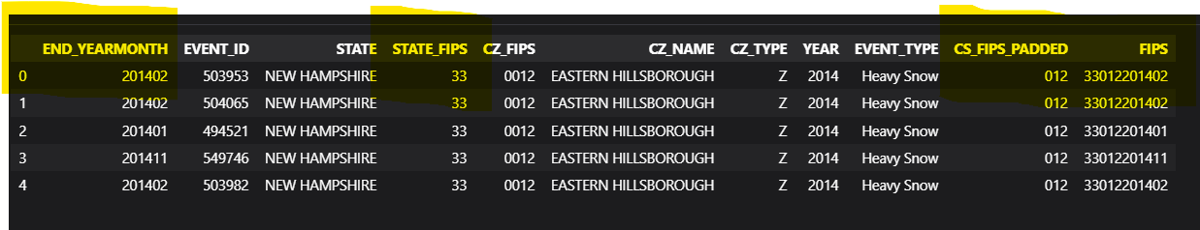
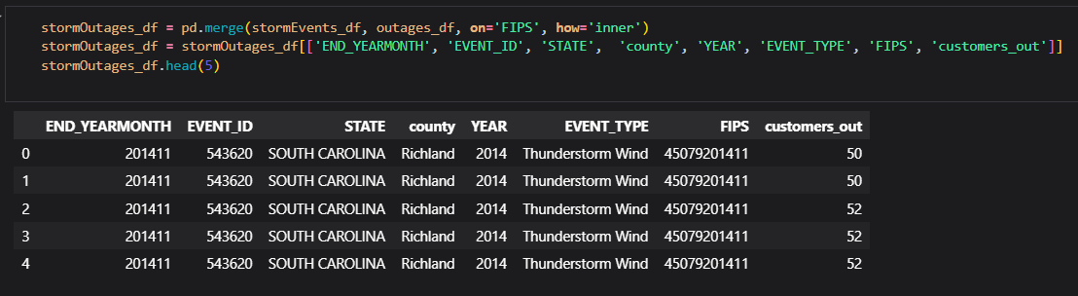
ETL Process - Continued
Unique FIPS code was created for both data sets
Concatenation of STATEFIPS + COUNTYFIPS + YEARMONTH
Merged data sets on custom FIPS code in to new data frame.
Export dataframe into csv and send to S3 bucket for ML analysis in colab

Slide 9
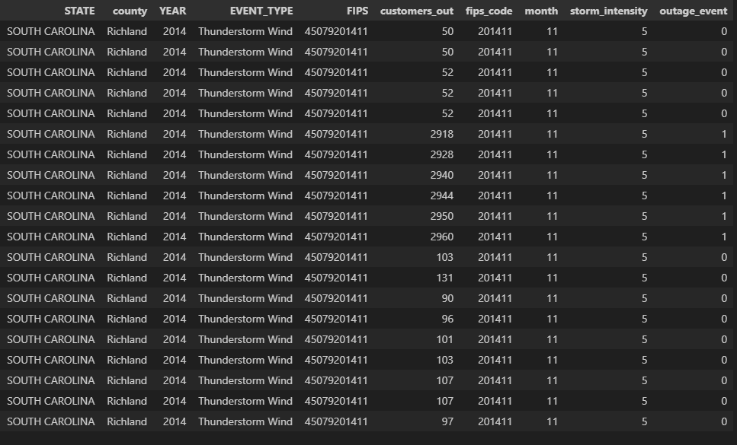
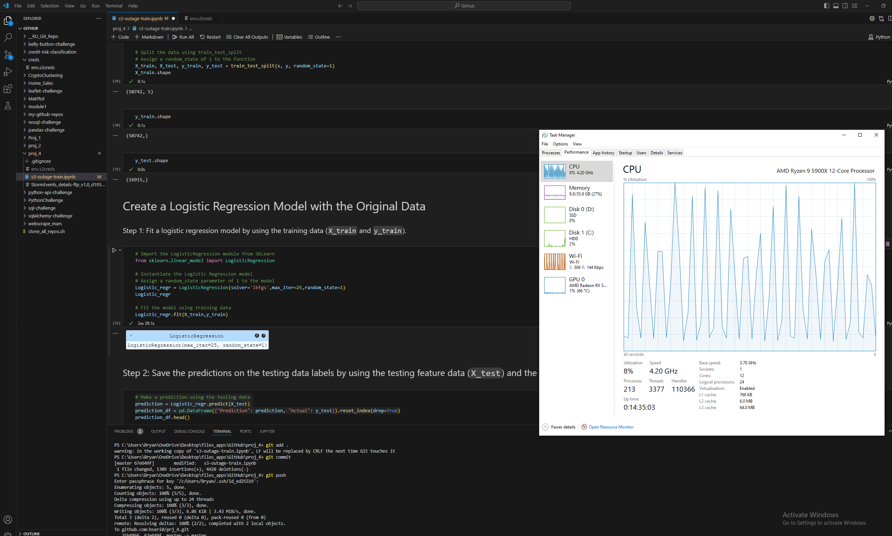
Machine Learning – Logistic and Linear Regression
Convert categorical data to weighted quantitative representation, convert location to FIPS numerical coded value, trim non-numeric data for models.
Sample DF of 25% data to help CPU, remove poor outage numbers of 1 customer out.
Logistic regression performed to determine “Storm Event” by calculating a threshold of <500
Linear regression performed on # of customers out dependent on all other numeric variables.

Slide 10
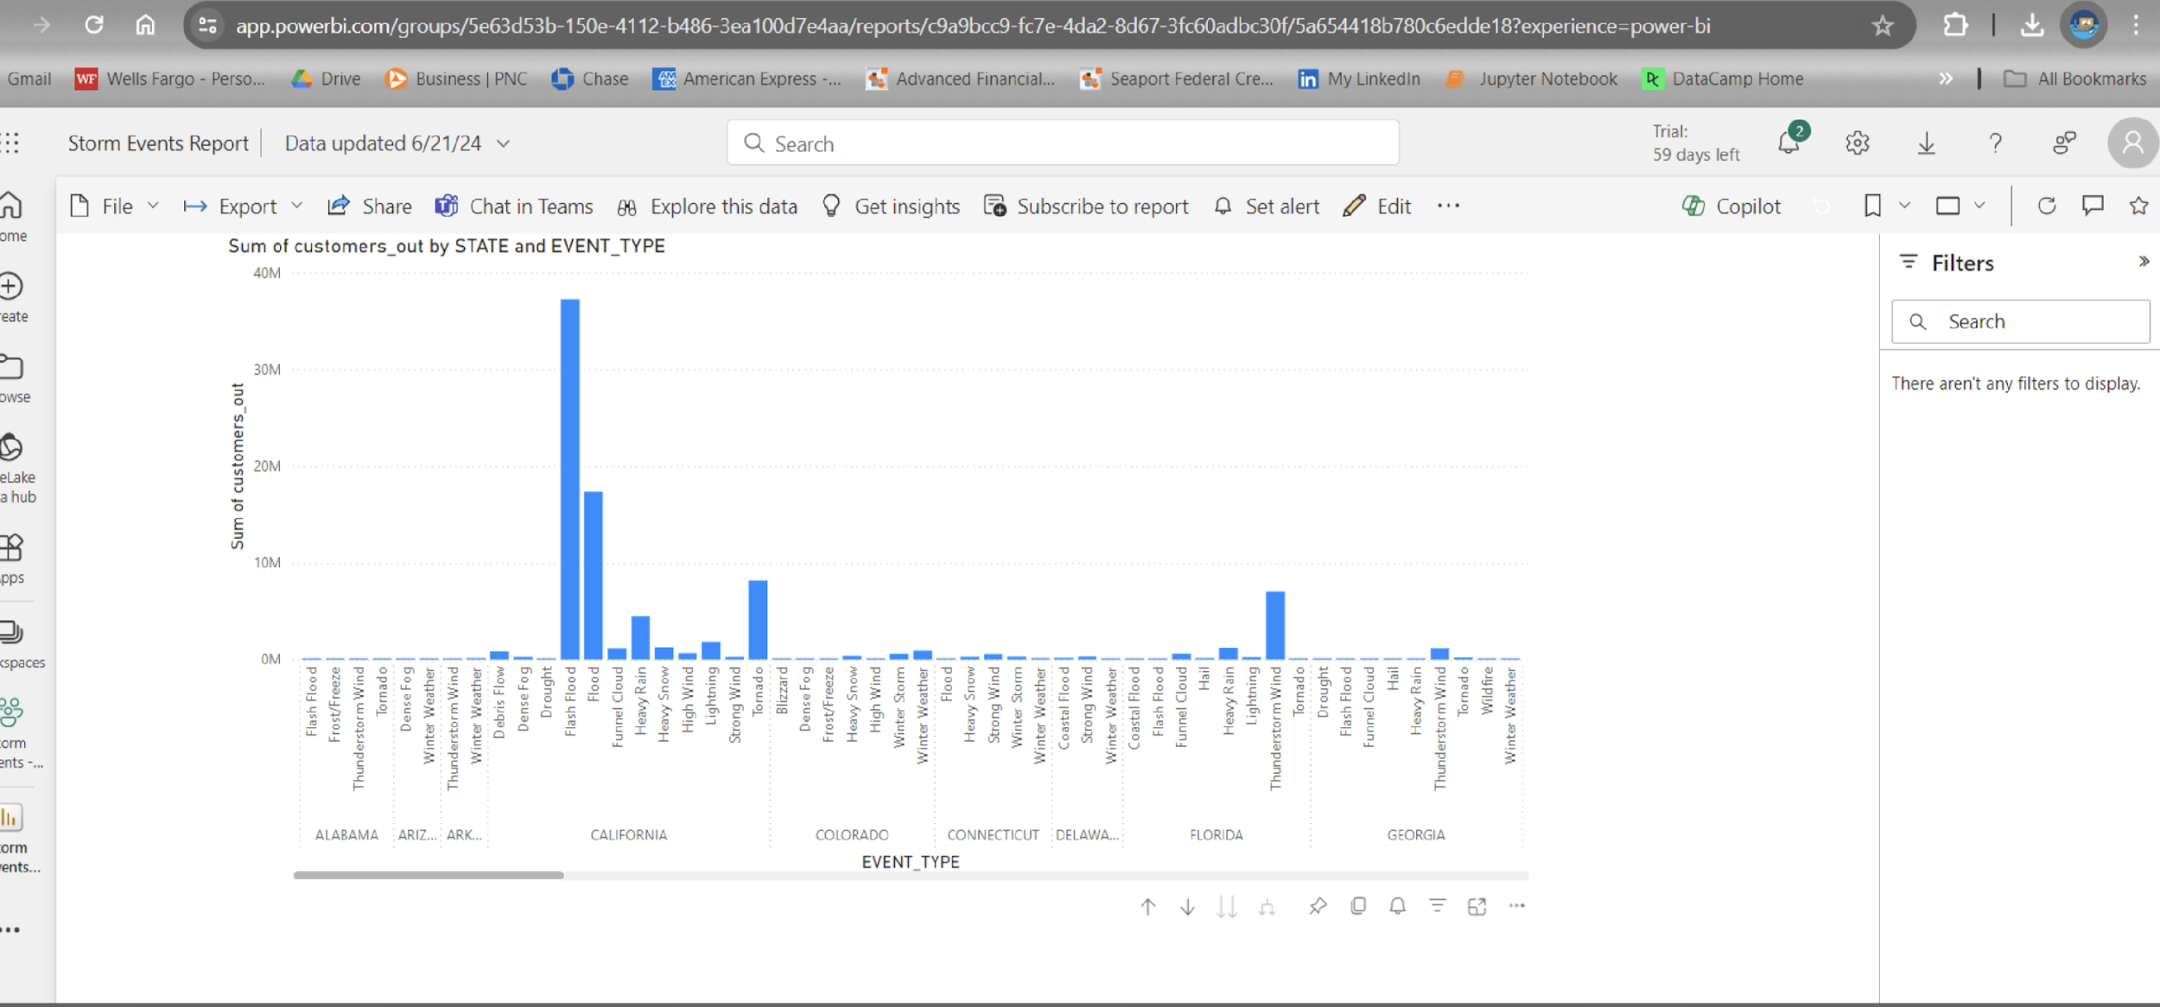
POWER BI REPORT - 01
POWER BI REPORT – Number of customers out of power by Outage Event Type in year 2014
ANALYSIS
Power outages in United States attributing to mainly FLOOD, TORNADOES & THUNDERSTORM related events

Slide 11
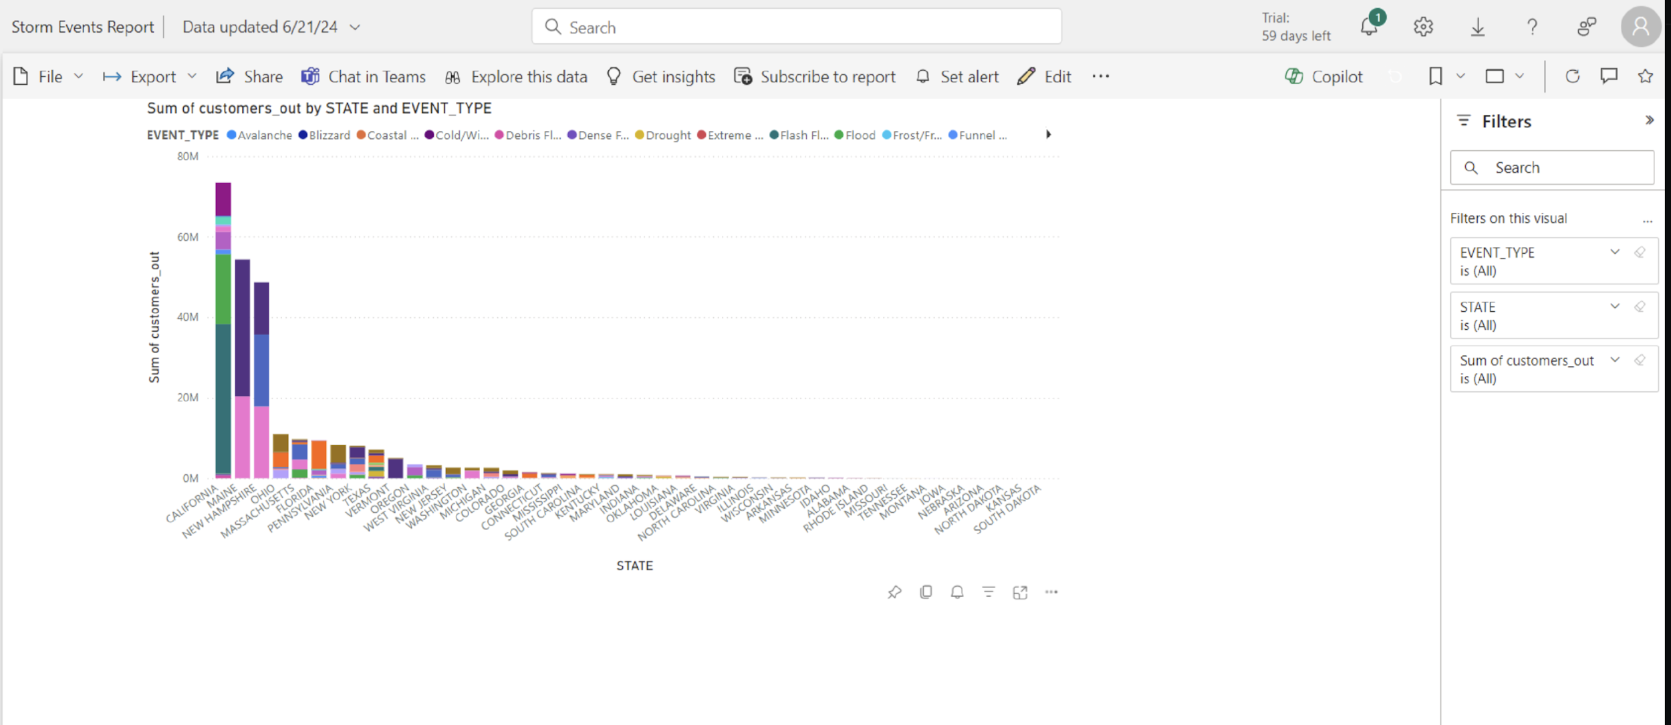
POWER BI REPORT - 02
POWER BI REPORT – Number of customers out of power by State and Outage Event Type Filters
ANALYSIS
Majority of the power outages in the State of California power outages attributing to FLOOD related events
North East states like Main & New Hampshire power outages are due to Debris or Dense

Slide 12





CONCLUSION | ACKNOWLEDGEMENTS
Raina Gustafson
Sheri Rosalia
Jeanette Luu
Enkhsanaa Sommers

Slide 13
REFERENCE
DATA & API
https://www.ncei.noaa.gov/access
https://www.eia.gov/electricity/
TECHNOLOGY
AWS S3
RDS PostgreSQL DB in AWS
RDS connection
Microsoft Power BI
Python Pandas and SciKitLearn

